Slide 1
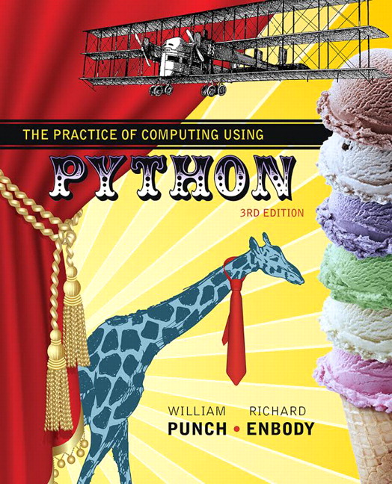
The Practice of Computing Using Python
Third Edition
Chapter 11
Introduction to Classes
Copyright © 2017, 2013, 2011 Pearson Education, Inc. All Rights Reserved
Notes:
If this PowerPoint presentation contains mathematical equations, you may need to check that your computer has the following installed:
1) MathType Plugin
2) Math Player (free versions available)
3) NVDA Reader (free versions available)

Slide 2
Code Listing 11.1 First Class

Slide 3
What is a Class?
If you have done anything in computer science before, you likely will have heard the term object oriented programming (O O P)
What is O O P, and why should I care?

Slide 4
Short Answer
The short answer is that object oriented programming is a way to think about “objects” in a program (such as variables, functions, etc)
A program becomes less a list of instruction and more a set of objects and how they interact

Slide 5

Responding to “Messages”
As a set of interacting objects, each object responds to “messages” sent to it
The interaction of objects via messages makes a high level description of what the program is doing.

Slide 6
Everything in Python is an object
in case you hadn't noticed, everything in Python is an object
Thus Python embraces O O P at a fundamental level

Slide 7
Type Versus Class
There is a strong similarity between a type and a Python class
seen many types already: list, dict, str, …
suitable for representing different data
respond to different messages regarding the manipulation of that data

Slide 8
O O P helps for software engineering
software engineering (S E) is the discipline of managing code to ensure its long-term use
rememember, S E via refactoring
refactoring:
takes existing code and modifies it
makes the overall code simpler, easier to understand
doesn't change the functionality, only the form!

Slide 9
More Refactoring
Hiding the details of what the message entails means that changes can be made to the object and the flow of messages (and their results) can stay the same
Thus the implementation of the message can change but its intended effect stay the same.
This is encapsulation

Slide 10
O O P Principles
encapsulation: hiding design details to make the program clearer and more easily modified later
modularity: the ability to make objects stand alone so they can be reused (our modules). Like the math module
inheritance: create a new object by inheriting (like father to son) many object characteristics while creating or over-riding for this object
polymorphism: (hard) Allow one message to be sent to any object and have it respond appropriately based on the type of object it is.

Slide 11



Class Versus Instance
One of the harder things to get is what a class is and what an instance of a class is.
The analogy of the cookie cutter and a cookie.

Slide 12
Template Versus Exemplar
The cutter is a template for stamping out cookies, the cookie is what is made each time the cutter is used
One template can be used to make an infinite number of cookies, each one just like the other.
No one confuses a cookie for a cookie cutter, do they?

Slide 13
Same in O O P
You define a class as a way to generate new instances of that class.
Both the instances and the classes are themselves objects
the structure of an instance starts out the same, as dictated by the class.
The instances respond to the messages defined as part of the class.

Slide 14
Why a class
We make classes because we need more complicated, user-defined data types to construct instances we can use.
Each class has potentially two aspects:
the data (types, number, names) that each instance might contain
the messages that each instance can respond to.

Slide 15
A First Class

Slide 16
Standard Class Names
The standard way to name a class in Python is called CapWords:
Each word of a class begins with a Capital letter
no underlines
sometimes called CamelCase
makes recognizing a class easier

Slide 17
Figure 11.2 The Basic Format of a Class Definition

Slide 18
dir() Function
The dir() function lists all the attributes of a class
you can think of these as keys in a dictionary stored in the class.

Slide 19
Pass Keyword
Remember, the pass keyword is used to signify that you have intentionally left some part of a definition (of a function, of a class) undefined
by making the suite of a class undefined, we get only those things that Python defines for us automatically

Slide 20
Our First Class

Slide 21
Constructor
When a class is defined, a function is made with the same name as the class
This function is called the constructor. By calling it, you can create an instance of the class
We can affect this creation (more later), but by default Python can make an instance.

Slide 22
Dot Reference
we can refer to the attributes of an object by doing a dot reference, of the form:
object.attribute
the attribute can be a variable or a function
it is part of the object, either directly or by that object being part of a class

Slide 23
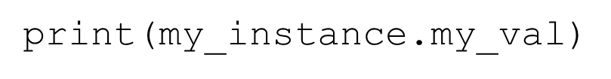
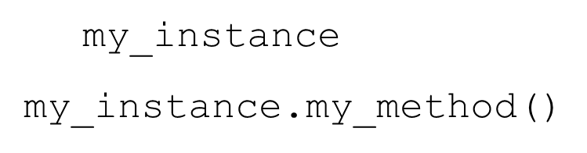
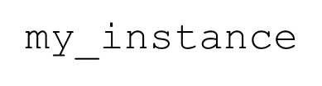
Examples
print a variable associated with the object
call a method associated with the object
variable versus method, you can tell by the parenthesis at the end of the reference

Slide 24
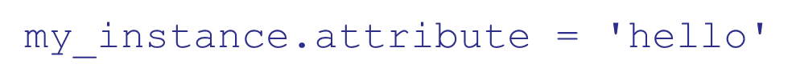
How to Make an Object-local Value
once an object is made, the data is made the same way as in any other Python situation, by assignment
Any object can thus be augmented by adding a variable

Slide 25
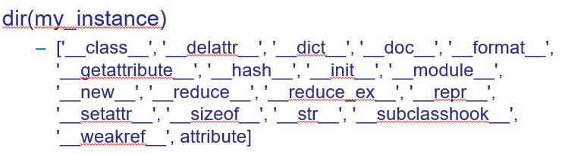
New attribute shown in dir

Slide 26
Class instance relationship

Slide 27
Instance Knows its Class
Because each instance has as its type the class that it was made from, an instance remembers its class
This is often called the instance-of relationship
stored in the __class__ attribute of the instance

Slide 28
The Special Relationship Between an Instance and Class: instance-of

Slide 29
Figure 11.3 The Instance-of Relationship

Slide 30
Scope
Introduced the idea of scope in Chapter 7
It works differently in the class system, taking advantage of the instance-of relationship

Slide 31
Part of the Object Scope Rule
The first two rules in object scope are:
First, look in the object itself
If the attribute is not found, look up to the class of the object and search for the attribute there.

Slide 32
Part of the Python Scope Rules for Objects: Instance, then Class

Slide 33
Figure 11.4 A Mixture of Local and Instance-of attribute relationships.

Slide 34
Methods

Slide 35
Code Listing 11.2

Slide 36
Method Versus Function
discussed before, a method and a function are closely related. They are both “small programs” that have parameters, perform some operation and (potentially) return a value
main difference is that methods are functions tied to a particular object

Slide 37
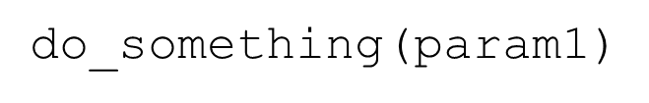
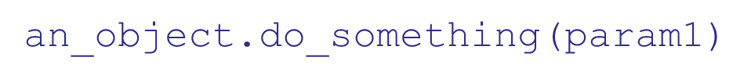
Difference in Calling
functions are called, methods are called in the context of an object:
function:
method:
This means that the object that the method is called on is always implicitly a parameter!

Slide 38
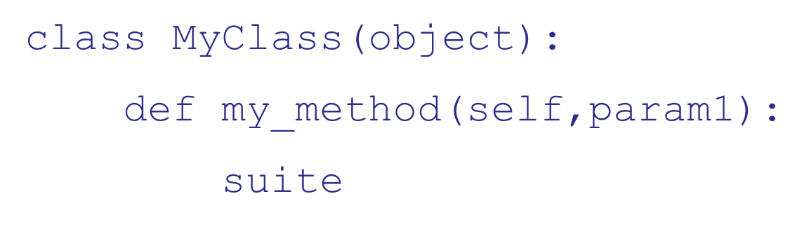
Difference in Definition
methods are defined inside the suite of a class
methods always bind the first parameter in the definition to the object that called it
This parameter can be named anything, but traditionally it is named self

Slide 39
More on Self
self is an important variable. In any method it is bound to the object that called the method
through self we can access the instance that called the method (and all of its attributes as a result)

Slide 40
Binding Self
How the calling object maps to self

Slide 41
Self is Bound for Us
when a dot method call is made, the object that called the method is automatically assigned to self
we can use self to remember, and therefore refer, to the calling object
to reference any part of the calling object, we must always precede it with self.
The method can be written generically, dealing with calling objects through self

Slide 42
Writing a class

Slide 43
Code Listing 11.3

Slide 44
Python Standard Methods
Python provides a number of standard methods which, if the class designer provides, can be used in a normal "Pythony" way
many of these have the double underlines in front and in back of their name
by using these methods, we "fit in" to the normal Python flow

Slide 45
Standard Method: Constructor
Constructor is called when an instance is made, and provides the class designer the opportunity to set up the instance with variables, by assignment

Slide 46
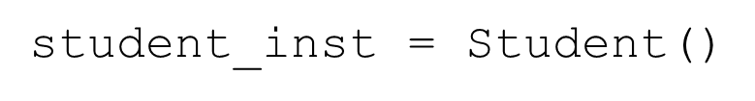
Calling a Constructor
As mentioned, a constructor is called by using the name of the class as a function call (by adding () after the class name)
creates a new instance using the constructor from class Student

Slide 47
Defining the Constructor
one of the special method names in a class is the constructor name, __init__
by assigning values in the constructor, every instance will start out with the same variables
you can also pass arguments to a constructor through its init method

Slide 48
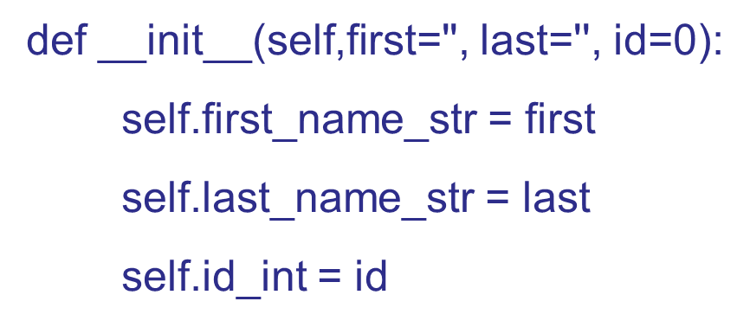
Student Constructor
self is bound to the default instance as it is being made
If we want to add an attribute to that instance, we modify the attribute associated with self.

Slide 49
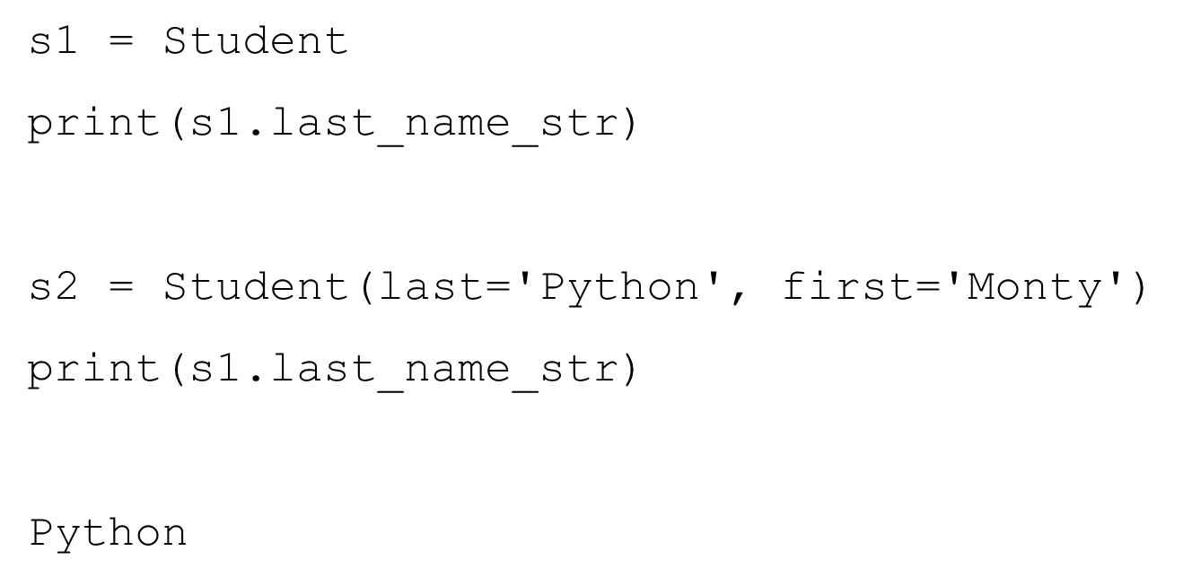
Example

Slide 50
Figure 11.6 How an Instance is Made in Python

Slide 51
Default Constructor
if you don't provide a constructor, then only the default constructor is provided
the default constructor does system stuff to create the instance, nothing more
you cannot pass arguments to the default constructor.

Slide 52
Every class should have __init__
By providing the constructor, we ensure that every instance, at least at the point of construction, is created with the same contents
This gives us some control over each instance.

Slide 53
__str__, Printing
When print(my_inst)called, it is assumed, by Python, to be a call to “convert the instance to a string”, which is the __str__ method
In the method, my_inst is bound to self, and printing then occurs using that instance.
__str__ must return a string!

Slide 54
Now there are three
There are now three groups in our coding scheme:
user
programmer, class user
programmer, class designer

Slide 55
Class designer
The class designer is creating code to be used by other programmers
In so doing, the class designer is making a kind of library that other programmers can take advantage of

Slide 56
Point Class, Code listings 11.4-11.7

Slide 57
Rule 9
Make sure your new class does the right thing
we mean that a class should behave in a way familiar to a Python programmer
for example, we should be able to call the print function on it

Slide 58
O O P Helps Software Engineering
software engineering is the discipline of managing code to ensure its long-term use
rememember, SE via refactoring
refactoring:
takes existing code and modifies it
makes the overall code simpler, easier to understand
doesn't change the functionality, only the form!

Slide 59
More refactoring (again)
Hiding the details of what the message entails means that changes can be made to the object and the flow of messages (and their results) can stay the same
Thus the implementation of the message can change but its intended effect stay the same.
This is encapsulation

Slide 60
OOP principles (again)
encapsulation: hiding design details to make the program clearer and more easily modified later
modularity: the ability to make objects “stand alone” so they can be reused (our modules). Like the math module
inheritance: create a new object by inheriting (like father to son) many object characteristics while creating or over-riding for this object
polymorphism: (hard) Allow one message to be sent to any object and have it respond appropriately based on the type of object it is.

Slide 61
We are still at encapsulation
We said that encapsulation:
hid details of the implementation so that the program was easier to read and write
modularity, make an object so that it can be reused in other contexts
providing an interface (the methods) that are the approved way to deal with the class

Slide 62
Private values

Slide 63
Class Namespaces are Dicts
the namespaces in every object and module is indeed a namespace
that dictionary is bound to the special variable __dict__
it lists all the local attributes (variables, functions) in the object

Slide 64
Private Variables in an Instance
many OOP approaches allow you to make a variable or function in an instance private
private means not accessible by the class user, only the class developer.
there are advantages to controlling who can access the instance values

Slide 65
Privacy in Python
Python takes the approach “We are all adults here”. No hard restrictions.
Provides naming to avoid accidents. Use __ (double underlines) in front of any variable
this mangles the name to include the class, namely __var becomes _class__var
still fully accessible, and the __dict__ makes it obvious

Slide 66
Privacy Example

Slide 67
Reminder, rules so far (1 of 2)
Think before you program!
A program is a human-readable essay on problem solving that also ahappens to execute on a computer.
The best way to improve your programming and problem solving skills is to practice!
A foolish consistency is the hobgoblin of little minds

Slide 68
Reminder, rules so far (2 of 2)
Test your code, often and thoroughly
If it was hard to write, it is probably hard to read. Add a comment.
All input is evil, unless proven otherwise.
A function should do one thing.
Make sure your class does the right thing.

Slide 69
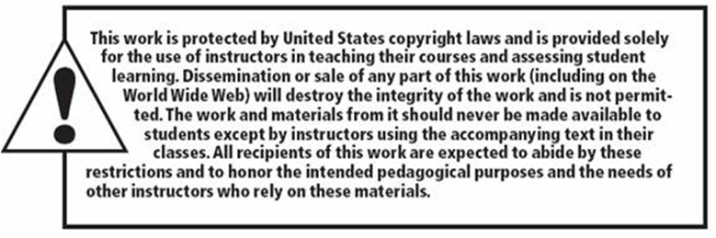
Copyright

